Slide 1
CAPSTONE PROJECT SHOWCASE
Project Title
Power BI Enabled Comprehensive Analysis on Unicorn Businesses
Abstract | Problem Statement | Project Overview | Proposed Solution | Technology Used | Modelling & Results | Conclusion | Q&A

Slide 2
Abstract
1
Analyze unicorn companies globally using Power BI.
2
Explore industries with the highest average valuation and annual unicorn production.
3
Creating visually appealing dashboards to illustrate unicorn company data.
4
Focus on companies valued over $1 billion, their funding, industry, country of origin, select investors, and founding years.

Slide 3


Problem Statement
Finding the investors who has funded the most of the Unicorn.
Which industry had both highest valuation and funding?
Which continent had the most industries?
Also which is the top 4 emerging industries?

Slide 4
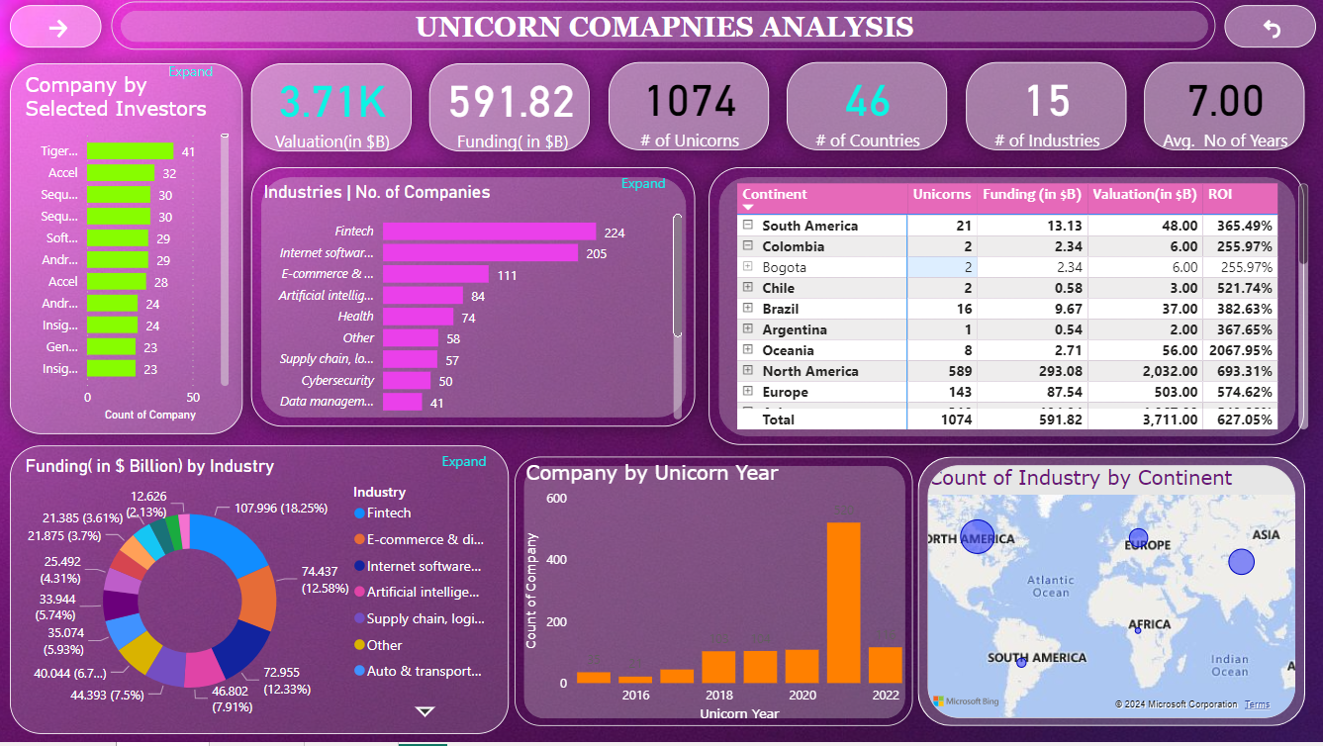
Project Overview
Data Collection, Cleaning Process and Pre-processing
Applying DAX Functions and Creating basic visualization
Utilize Power BI for data visualization and analysis of unicorn companies’ data
Formatting and testing the data and visuals
Focus on companies valued over $1 billion, their funding, industry, country of origin, select investors, and founding years

Slide 5
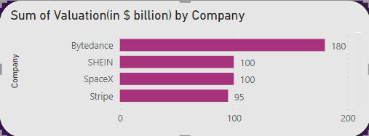
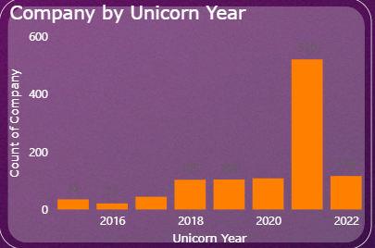
Proposed Solution
There are 1074 Companies and 15 Industries in total in different countries.
Bytedance, SHEIN, SpaceX, Stripe, Klarna are the top 5
Emerging companies.
In 2021 most of the companies have joined UNICORNS.
Fintech, Internet software & service, E-commerce & direct-to – customer, Artificial Intelligence are top 4 emerging industries.
United States and China have more number of Industries and Companies.

Slide 6
Technology used
POWER BI

Slide 7
Modelling & Result : Dashboard-01
This page shows an overall Dashboard of the Unicorns with distribution by unicorn country and industry.

Slide 8
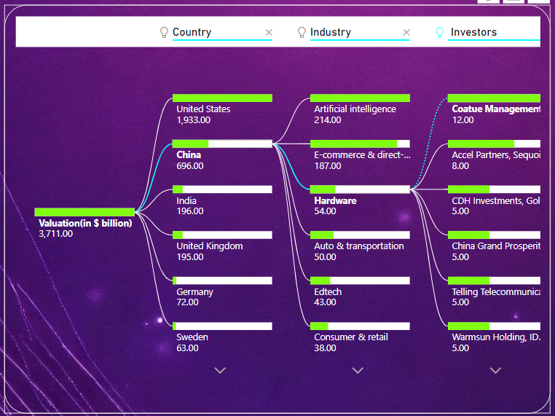
Modelling & Result : Dashboard-02
Valuation $ Decomposition
In this visual we decompose the valuation ($B) and break it down by Country, Industry and Investor to have a tree like visual.

Slide 9
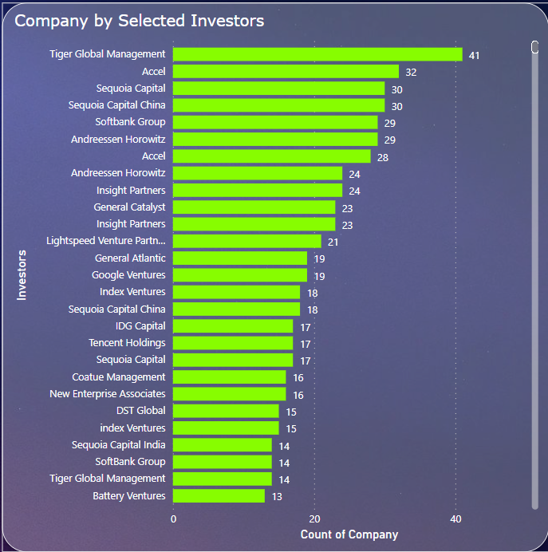
Modelling & Result
This shows the selected investors who had invested in many no. of companies,
In which, Tiger Global Management, Accel and Sequoia Capital are the top 3 investors

Slide 10

Conclusion
In conclusion, the project provides a detailed analysis of unicorn companies, highlighting their financial standing, industry trends, and key visualizations to in understanding this unique segment of the business world.

Slide 11

Notes:
Thank You !!

